Slide 1
Save Patient Access to Home Medical Equipment
Importance of HME
HME Providers Endure COVID-19
Declining Reimbursement
Declining HME Providers in NY
Cost of Delivery

Slide 2
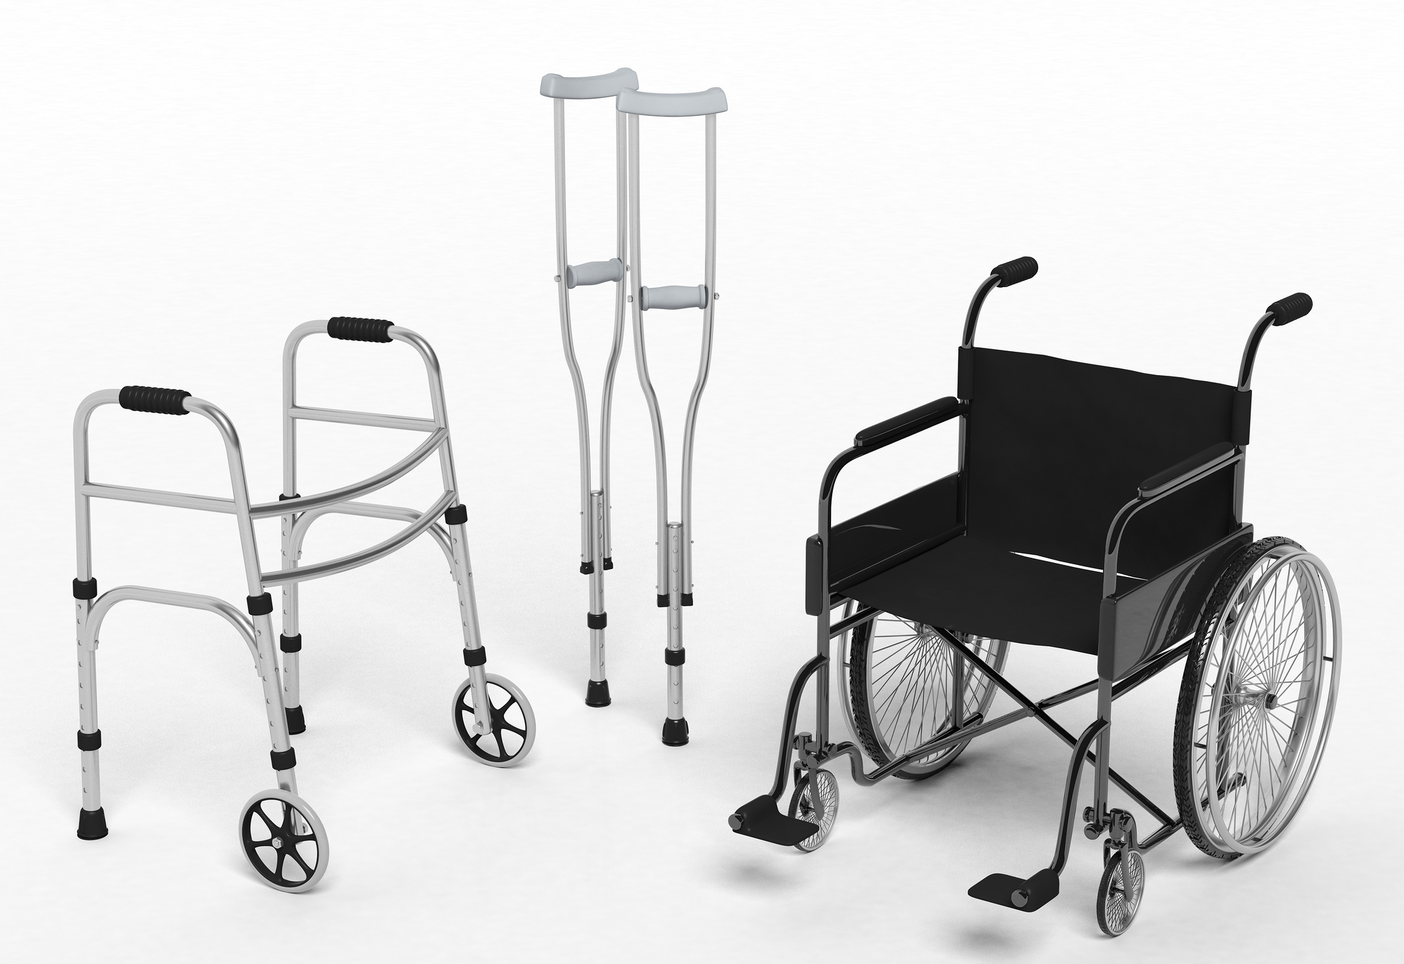
What you need to know about Home Medical Equipment (HME)
Home Medical Equipment (HME) providers have long gone under the radar providing necessary products and services to the homebound and patients recently discharge from a hospital. Overshadowed by hospital and physician care, HME is often overlooked when it comes to distribution of funds and other needs. Once a patient is discharged from the hospital, necessary HME is provided but goes unnoticed. As we have seen recently with the COVID-19 pandemic, healing at home is becoming more important allowing other critical patients a bed in a hospital and saving the country billions of dollars.

Slide 3
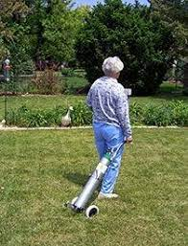
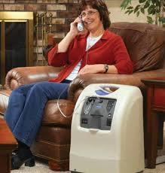
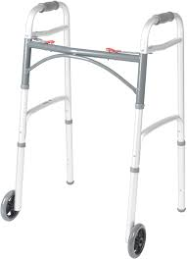
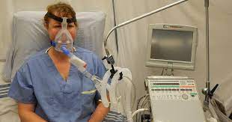
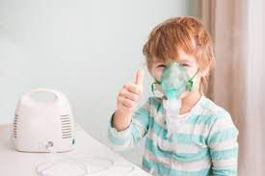
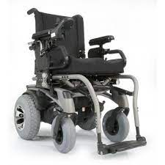
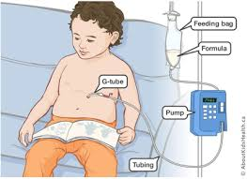
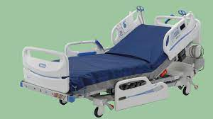
Commonly Prescribed HME
Oxygen (stationary and portable)
Ventilator
BiLevel Positive Airway Pressure
Continuous Positive Airway Pressure
Tracheostomy Care
Enteral Nutrition
Nebulizer
Hospital Beds
Wheelchair
Custom Wheelchair
Ambulatory Aids

Slide 4
HME Providers Enduring COVID-19
When the hospitals were too full, HME providers continued delivering to at risk and COVID positive patients.
Scrambled/Struggled to find appropriate PPE for their employees to continue servicing their patients in need.
Worked with manufacturers to get equipment as expeditiously as possible.
Donated ventilators to local hospitals
Helped nursing homes stock high levels of concentrators in preparation for the role they played
Quickly engaged respiratory therapists to help staff hospitals and educate hospital employees across the country on how to use the various kinds of ventilators.
Developed new approaches with BIPAP AVAPS so hospitals could use it to invasively or as a secondary form of treatment
Partnered with area hospitals to discharge patients who were able to be taken care of at home as quickly as possible to create room for COVID-19 patients
We are here!

Slide 5
HME - A Neglected Industry
These HME services have always been necessary, and the services that come with it are essential. This is what patients, and their insurance carriers were paying for.
While the HME industry tends to go unnoticed, the services and care that come with it are imperative in assisting patients live their lives to the fullest and make the world around them more accessible. It is our hope that the more awareness is generated for the HME industry and the needs that come with it, the easier it will be for the HME providers to continue providing these essential services to those who rely on them in order to live their lives without limitations.

Slide 6
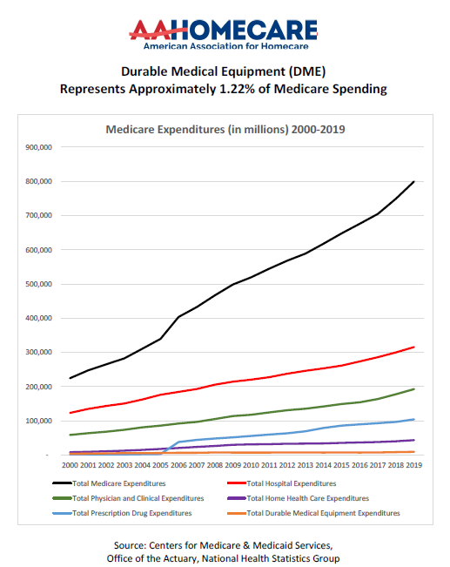
Medicare Spending Chart HME Represents 1.22% of Medicare Spending

Slide 7
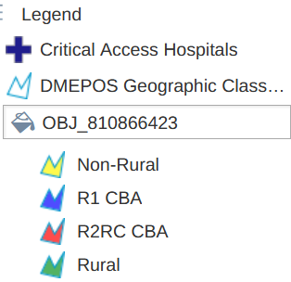
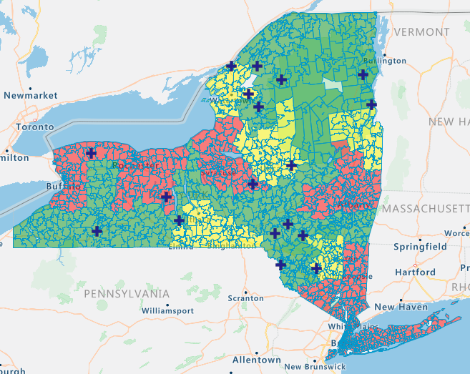
New York DMEPOS Geographic Classification
The Centers for Medicare and Medicaid Services (CMS) classifies durable medical equipment reimbursement rates based on the physical location where a beneficiary resides. These categories are divided into three categories: Competitive Bidding Areas (CBAs), Non-Rural and Rural. These areas are determined by a Zip Code’s geographic area being within a metropolitan area regardless of distances to other suppliers or proximity to a critical access hospital (CAH).
Classification | Oxygen concentrator reimbursement rate in 2015 | Oxygen concentrator reimbursement rate during PHE | Percentage change
Rural | $180.92 | $136.22 | -24.7%
Non-rural | $180.92 | $101.70 | -43.8%
CBA | $180.92 | $76.03 | -58.0%

Slide 8
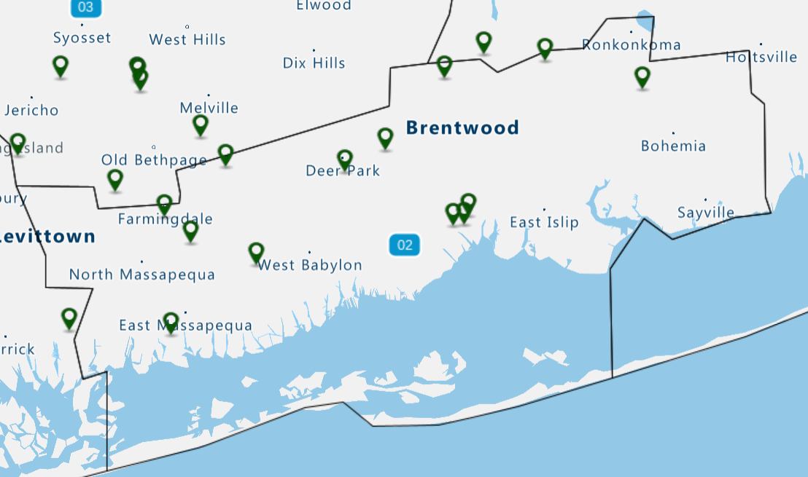
HME Suppliers in New York
2010 supplier count: 641
2021 supplier count: 354
Percentage decrease:
-45%

Slide 9
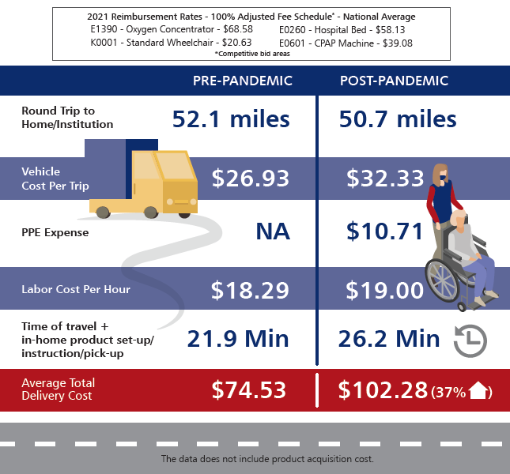
Delivery Cost for the Mideast Region
We have conducted a survey of nearly 100 independent home medical equipment providers to reflect the real costs of providing equipment before and during the public health emergency.

Slide 10
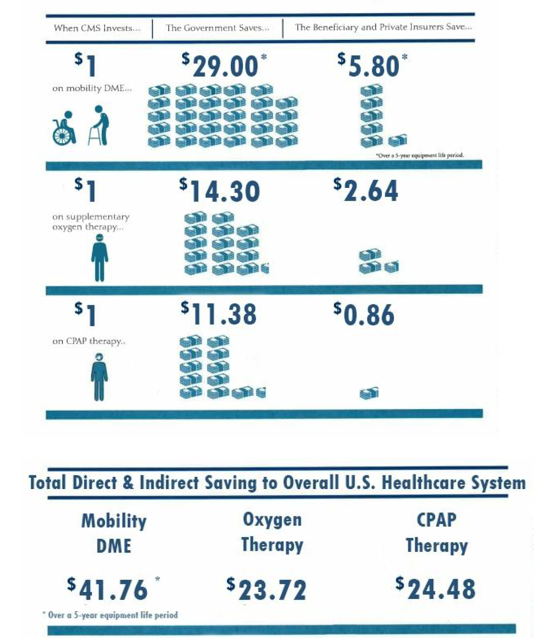
The Case for Medicare Investment in Durable Medical Equipment
For every dollar that Medicare currently spends providing mobility DME, Medicare actually avoids paying an additional $29.00 over a five-year equipment life period for fall-related emergency room visits, hospital stays, doctor visits and outpatient care that would result without that equipment.
For every dollar that Medicare pays to provide supplemental oxygen therapy, Medicare avoids paying $14.30 for treatment of COPD-caused medical complications and comorbidities in one year that would result if the oxygen therapy was not provided.
The breakeven period for this return is 26 days.
For every dollar that Medicare pays to provide CPAP therapy, Medicare avoids spending a minimum of $11.38 for treatment of OSA-caused medical complications in one year that would result if the CPAP therapy was not provided.

Slide 11
History of DME/HME Cuts: -$80 Billion Since 2010
1997: Balanced Budget Act: -30% Oxygen Reimbursement
2003: Medicare Modernization Act: $7 Billion Reduction Over 10 Years
2005: Deficit Reduction Act: $500 million Oxygen Reduction. Capped Medicare Oxygen
2008: Medicare Improvements for Patients & Providers Act (MIPPA): $3-4 Billion (9.5%) Reduction Competitive Bidding Program
2010: Patient Protection & Affordable Care Act (ACA): $6-8 billion over 10 years-accelerating competitive bidding program. Eliminates the 1st month purchase option for power wheelchairs
2011: Competitive Bidding Program Round 1: 32% Reduction Over 3 years for 9 Metropolitan areas
2013: Competitive Bidding Program Round 2: 45% Reduction Over 3 Years for 100 Metropolitan areas. 72% reduction for diabetic testing supplies.
2014: Competitive Bidding Program Round 1 Re-Compete: 37% Reduction in 9 Metropolitan areas
2014: 4.4 Billion reduction over 5 years in select HME nationwide starting Jan 2016
2015: Competitive Bidding Prices for Complex Rehab Technology
2015 CMS Notice: Ventilators 33.5% Reduction Starting Jan 2016
2015 Omnibus Bill: 4.3 billion reduction over 10 years in state Medicaid programs by limiting federal portion of the Medicaid funding to the 2019 Competitive Bid Rates

Slide 12
Impact on Beneficiary Access, Supplier Consolidation
A study by Dobson DaVanzo revealed that suppliers are only reimbursed 88% of their overall costs by Medicare, concluding that “The [Competitive Bidding] process is fundamentally flawed in that CMS is currently paying the industry far less than the total costs incurred in providing DMEPOS goods and services to Medicare beneficiaries” and that it “has the potential to significantly impact beneficiary access to medical equipment and harm the DMEPOS industry as a whole”.

Slide 13
The HME industry needs help
We need your support to help protect access to medically necessary Durable Medical Equipment (DME) products and services for Medicare beneficiaries.
Our ask for you is to assist with…
Providing support to maintain the adjusted/non-adjusted reimbursement “blends” for rural (50/50) and non-rural ZIPs (75/25) for DME reimbursement indefinitely after the declared Public Health Emergency (PHE) is over.
We also ask for a similar 75/25 blend in the 130 large metropolitan areas (MSAs) that remain with low “competitive bid area” (CBA) reimbursement rates. CBAs make up slightly more than half of the Medicare population, and have been, arguably, most affected by the PHE. In addition, these areas are, frequently, underserved with respect to appropriate patient care.
This will not only assist DME suppliers to remain in business but allow Medicare beneficiaries to obtain the quality products and services they need. These blended payments should last not just through the end of the PHE (as proposed by CMS-1738-P), but until the product categories can be re-bid under a program structured to reflect true market conditions.
We are looking for a lead to sponsor legislation that would improve accessibility and reimbursement for home medical equipment.

Slide 14
Thank you!
Northeast Medical Equipment Providers Association
https://northeastmep.org/
Beth Bowen, Executive Director Email: beth@northeastmep.org
Direct Dial: (919) 387-1221

